Slide 1
High Definition Phenotype (HDP)
Nam
Objective: to construct the HDP and evaluate its usefulness in predicting neonatal mortality in neonatal intensive care unit (NICU)neonatal intensive care unit

Slide 2
Methods
Setting: the study was conducted in eight Level-3 NICUs with similar infrastructure and patient care facilities across India with 1546 patients who were in the NICU for more than 24 hours and had continuous parameters recorded
Data were collected through an EMR platform to build the HDP time-series data structure
Deep Learning Models: used two types of models:
Logistic Regression Model (LRM)
Long Short Term Memory LSTM-based deep learning model. LSTMs were chosen due to their success in modeling complex dependencies in time-series data, which is particularly relevant in a clinical setting.
Model Performance Testing: The study tested the performance of LRM and LSTM models at different time points during a patient's stay to generate prediction models. The models' performance was compared with other severity scores used in NICU settings (SNAPPE, SNAPPE-II, CRIB, and CRIB-II).
Data: The study divided data into primary and derived categories.
Primary data included well-defined clinical parameters like birth weight, heart rate, temperature, and more.
Derived data parameters were extracted from primary data and represented additional information such as trends or variability. Both primary and derived parameters were categorized as:
Fixed parameters don't change during a patient's hospitalization.
Intermittent parameters are collected periodically.
Continuous parameters are fine-grained, time-stamped data.
Model Development: The study used a leave-one-out cross-validation strategy for both the LRM and LSTM models. Synthetic Minority Oversampling Technique (SMOTE) was used to balance the training set for the LRM.

Slide 3
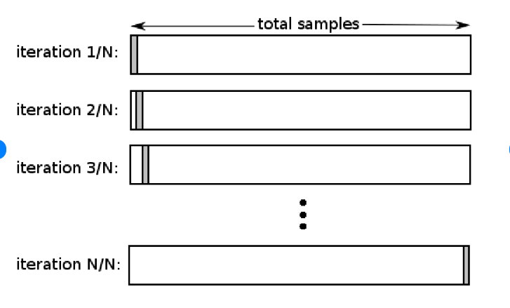
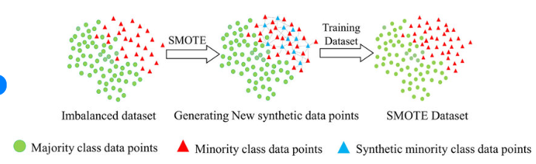
Leave-One-Out Cross-Validation (LOOCV):
validation technique used to assess the performance of predictive models.
In LOOCV, each data point in the dataset is taken as the test set, while the remaining data points are used as the training set.
The model is trained and tested iteratively, with each data point serving as a test point exactly once.
LOOCV is beneficial in scenarios with limited data, as it maximizes the use of available data for model evaluation.
It provides a more accurate estimate of how the model is expected to perform on unseen data, as it tests the model against all possible combinations of training and testing sets.
Synthetic Minority Oversampling Technique (SMOTE): is a technique used to address class imbalance in the training dataset, particularly when one class (the minority class) is underrepresented compared to another class (the majority class).
In the context of the LRM model, SMOTE was used to balance the training set by oversampling the minority class. It works by generating synthetic samples for the minority class by interpolating between existing data points. This helps improve the model's performance by reducing the bias that can be introduced when one class dominates the training data.
For example, in a medical context, where the number of patients with a certain condition is much smaller than those without the condition, SMOTE can be applied to create synthetic data points for patients with the condition, making the dataset more balanced and ensuring that the model doesn't become biased toward the majority class.

Slide 4
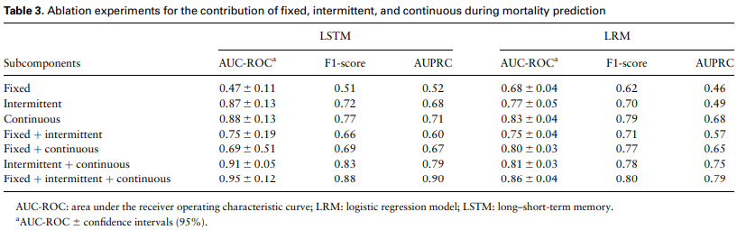
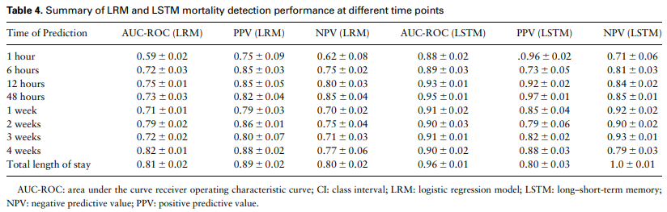
Results
Ablation experiments: were conducted to assess the importance of different types of parameters (fixed, intermittent, and continuous) in predicting outcomes.
The results indicated that when continuous parameters were considered alone, they exhibited the best predictive performance, with AUC scores of 0.83 for LRM and 0.88 for LSTM.
However, a combination of the 3 parameters significantly improved the AUC scores to 0.86 for LRM and 0.95 for LSTM. This underlines the significance of considering a comprehensive set of parameters, including both primary and derived data, to enhance predictive accuracy.
Model Performance:
The performance of the models in predicting mortality was evaluated at various time points, ranging from 1 hour to 4 weeks. The study found that the LRM achieved its best performance at the 4th week, while the LSTM excelled at the 48th hour.
This demonstrates that the models can provide mortality predictions at different stages of a patient's stay in the NICU.

Slide 5
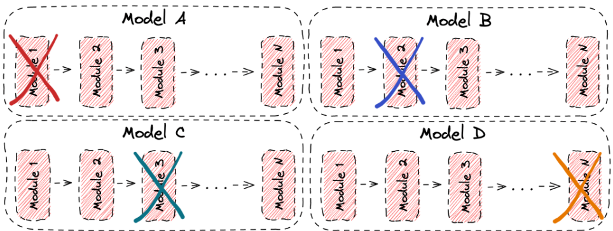
Ablation Study in Machine Learning
Most times in machine learning, we implement models that consist of multiple different parts that influence the total performance. Therefore, it is very important to provide ways to measure the contribution of these parts to the overall model. This is where the concept of an ablation study comes where certain parts of the network are removed in order to gain a better understanding of the network’s behavior.
In the image below, we can see an example of an ablation study in a model with N modules. Each time we remove one of the modules and check the performance of the new model to investigate the influence of the removed module:

